Slide 1


AstroSage Call Center Optimization
Strategic Investment Analysis for Operational Excellence
Submitted by:
Purushotam Kumar
August, 2025

Slide 2
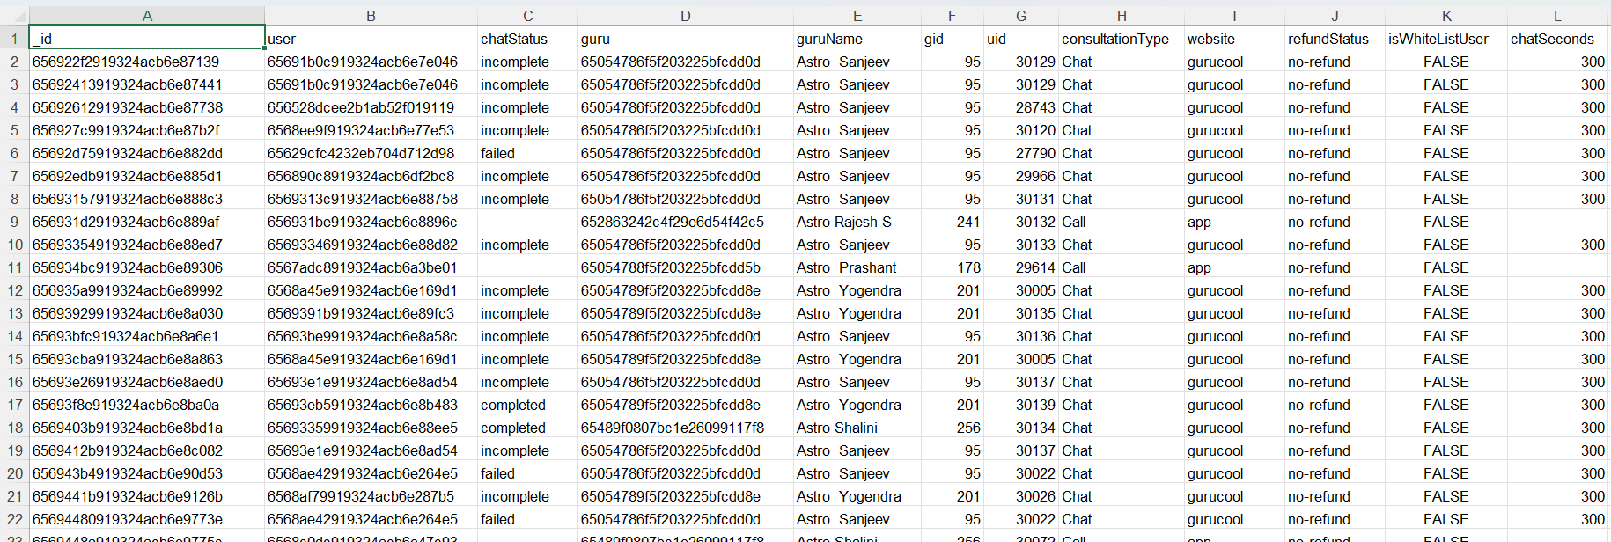
Problem Statement
AstroSage runs a large, multi-channel call center that handles thousands of customer interactions each day. However, increasing customer expectations, seasonal fluctuations in demand, and operational inefficiencies are putting pressure on profitability. This analysis highlights key performance gaps and proposes a strategic investment of ₹1 Crore to streamline operations and improve overall customer satisfaction.

Slide 3

Data Overview
Served 2,8027 unique users supported by 131 gurus.
Dataset spans 34 days of operations across India.
Recorded 8,512 total calls, with 41% completed, 14% failed, and 10% incomplete.
The data provides insights into customer behavior and operational performance, enabling trend analysis and process optimization.

Slide 4
Data Cleaning & Preparation
Handle missing values and blank data cells across the dataset.
Normalized date values in day, month and year for daily, monthly and yearly reports.
This dataset allows for an in- depth understanding of AstroSage market presence and operational scope.
A good dataset is important to understand the operational cost , customer satisfaction and trend in the sales of call center.
This dataset enable us to predict and suggest future investments to grow the sales Turnover. REPHRASED IT

Slide 5
Analytical Approach
Data Cleaning: Applied spreadsheet functions such as TRIM and duplicate removal to improve data quality and accuracy.
Data Enrichment: Generated additional variables using date functions to enable more detailed and meaningful analysis.
Customer Segmentation: Used sorting and filtering to group customers by consultation type, summarize key metrics, and identify patterns across metrics and product categories.
Visualization: Built an interactive dashboard with multiple charts to provide clear insights and a comprehensive view of the dataset.

Slide 6
DayWise Change in Call Volume
Call volume varies daily, with clear declines following peak activity periods.
Peak performance is observed towards the end of the week.
Lower activity at the mid week then increase gradually.

Slide 7
Revenue Generated By Each Category
Multi-channel revenue streams show chat's emerging profitability and call center's core strength
The call channel generates the highest revenue.
Chat produce lower revenue.
Complementary consultations and public live call channels do not generate direct revenue.

Slide 8
Website Distribution
GuruCool accounts for approximately 72% of total interactions (20,225).
The mobile app represents around 28% (7,800 interactions).
Dashboard usage remains low.

Slide 9
Call Status Distribution
Most calls are successfully completed.
A notable proportion of busy and incomplete calls.
Failed and unanswered calls are still present.
44% call is unperformed which need attention.

Slide 10
Chat Status Distribution
Most chats are completed successfully.
A large number of pending and ongoing chats
Failure and incomplete chat rates remain relatively low.
74% unsuccessful chat suggests an opportunity to improve response.

Slide 11
Hourly Load Patterns & Peak Hours
Call volume rises quickly after 5 AM.
Peak hours are between 6 AM and 11 PM.
Activity is low during early morning (12 AM–7 AM).
Call volume decreases again after 9 PM.
More staff is needed during peak hours and less during late night

Slide 12
Guru Evaluation Score: 8 out of 8
The chart shows uneven performance across Guru IDs, indicating variability in contribution levels.
A few gurus have significantly higher activity, while many remain at moderate or lower levels.
This suggests the need to focus on improving consistency and boosting low-performing gurus.

Slide 13
Top 10 Agents (By Performance)
Astro SHALINI leads by a significant margin, managing more than twice the number of calls compared to other Gurus.
The uneven distribution indicates a need to better balance workloads to ensure consistent service quality across the team.
This also presents an opportunity for mentorship.

Slide 14
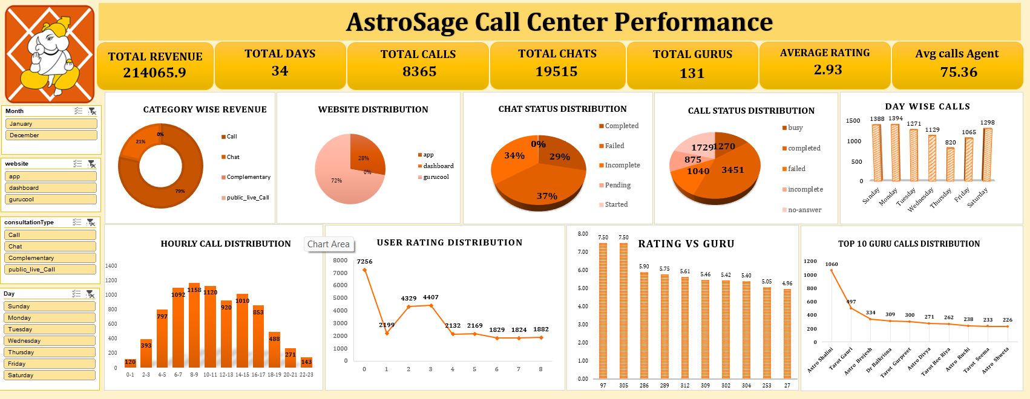

Slide 15
Key Strategic Insights
Modernize Technology Infrastructure
Adopt a cloud-based omnichannel platform with intelligent routing, real-time monitoring, and automated callbacks to reduce high failure rates (59% calls, 71% chats) and enhance service reliability and user experience.
Optimize Workforce Management (WFM)
Leverage AI-driven scheduling, demand forecasting, and flexible staffing to better align resources with the extended 6 AM–5 PM peak period, minimizing agent fatigue and improving productivity and engagement.
Implement Targeted Capability-Building Programs
Strengthen the current 2.93/8 service rating through continuous, role-specific training focused on communication, tool proficiency, and customer engagement to improve overall service quality and performance.

Slide 16
Key Strategic Insights
Strengthen Channel Strategy for Revenue Growth
Since calls generate nearly 79% of total revenue while chats face high failure rates, prioritize stabilizing call operations and simultaneously enhance the chat
Implement AI-Driven Automation and Analytics
Minimize manual effort by deploying AI chatbots for initial customer support and using real-time analytics to track sentiment and performance
Introduce Performance-Based Incentive Programs
Correct workload imbalance—where the top 10 agents manage 44% of calls—by offering performance-linked incentives that reward efficiency, productivity, and high-quality customer service.

Slide 17
Conclusion Summary Of Findings
Operational Challenges
High system failure rates and uneven workload distribution have emerged as key operational constraints.
Customer Satisfaction Concern
An average customer satisfaction score of 2.93/8 highlights the urgent need to improve service quality and overall user experience.
Revenue Channel Performance
Calls remain the dominant revenue driver, contributing 79% of total revenue, while the chat channel continues to lag in performance and efficiency.

Slide 18
Conclusion Summary Of Findings
Modernize Technology Infrastructure
Upgrade existing systems to remove operational inefficiencies and ensure smoother, more reliable workflows.
Step 2: Strengthen Capabilities with Training & AI
Combine continuous skill development with AI-powered tools to improve service consistency and overall quality.
Step 3: Use Data-Driven Workforce Planning
Apply smart scheduling and analytics to align staffing with demand and maximize agent productivity during peak hours.
Step 4: Build a Performance-Driven Culture
Introduce performance-based rewards to boost motivation, maintain workload balance, and support long-term productivity.

Slide 19
RECOMMENDATION
Reference (Investment Allocation Plan 1 crore rupees)
₹25 Lakhs – Agent Training & Quality Improvement
₹30 Lakhs – Technology & Automation Tools
₹20 Lakhs – Hiring & Capacity Expansion
₹10 Lakhs – Performance Incentives & Retention
₹10 Lakhs – Digital Infrastructure & Cloud Upgrades
₹5 Lakhs – Customer Feedback & Analytics Systems

Slide 20
FINAL EXPECTED OUTCOME
20–30% reduction in failed and incomplete calls
Improvement in customer satisfaction (CSAT increase by ~1 point)
Faster query resolution and enhanced service quality
Better workload distribution and reduced agent burnout
Increased revenue through improved efficiency and conversion rates

Slide 21
Final Outlook
Strengthen customer satisfaction and loyalty by delivering reliable, high-quality service experiences.
Improve operational efficiency through smart automation and optimized workforce scheduling.
Increase profitability by boosting completion rates and optimizing revenue channels.
Build a motivated and balanced workforce focused on consistently providing excellent customer service.

Slide 22


